Slide 1
Prediction of road Accident Traffic 1.0
Jobless Coder: Vikas Pal, Rajesh , Sumit and Rahul

Slide 2
PROBLEM STATEMENT :
Road Traffic Accidents (RTAs) are a major cause of death globally leading to around 1.25
million deaths and 50 million injuries every year.
Developing a system that is able to used the past data and provide better and safe ways of living.
Also helps to provide to overcome the kind of traffic accident.

Slide 3
OBJECTIVE :
Our end goal is to create an accurate RTA prediction model in the UK and user-friendly
web interface that incorporates.
An simple explanation of the model itself.
Visuals that highlight the importance of various factors in predicting RTAs.
An interactive dashboard that allows user to input values and immediately obtain
probabilities of RTAs occurring in various parts of the UK.
Provide the Routing Facilities if there is an accident prone region is found.

Slide 4
OUR APPROACH :
DATA COLLECTION
DATA ANAYSIS
KAGGLE + WEATHERAPI
CLEANING + VISUALIZATION +
SUPERVISED APPROACH
DEPLOYMENT
TRAINING + EVALUATION
FLASK (BACKEND)

Slide 5
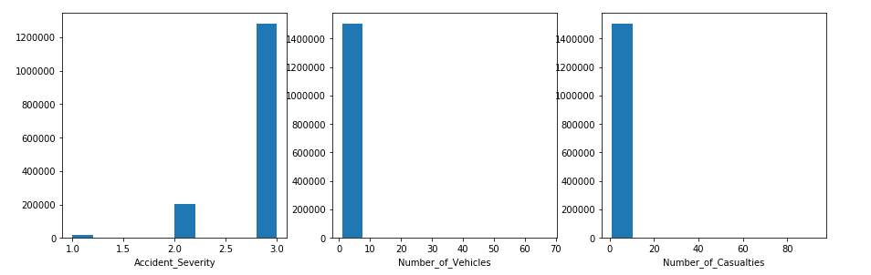
Exploration and Observation :

Slide 6
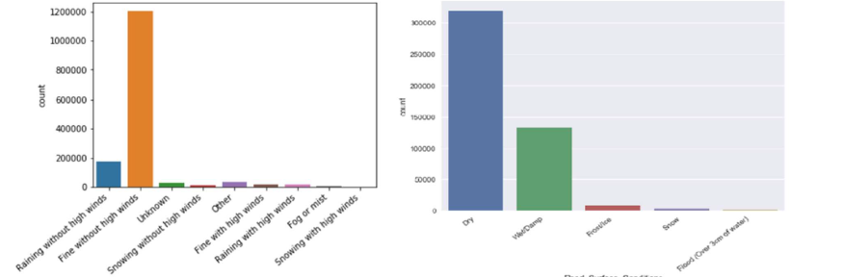
Exploration and Observation :
Weather Data :

Slide 7
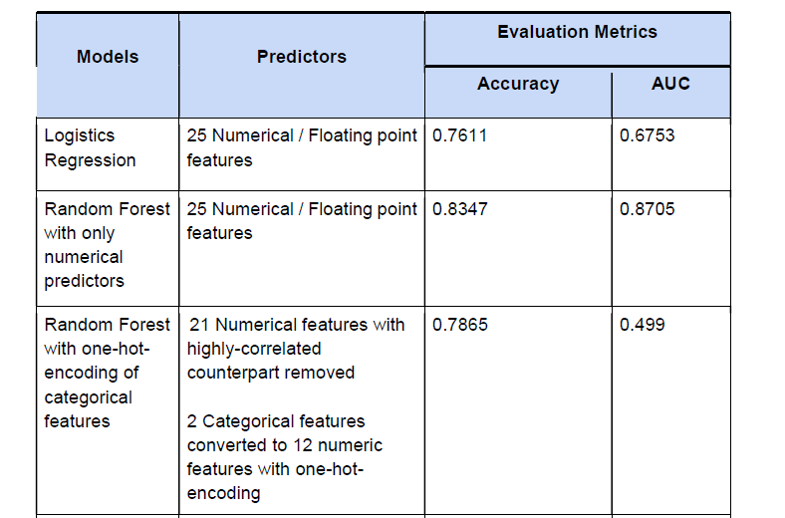
ML Algorithm :

Slide 8
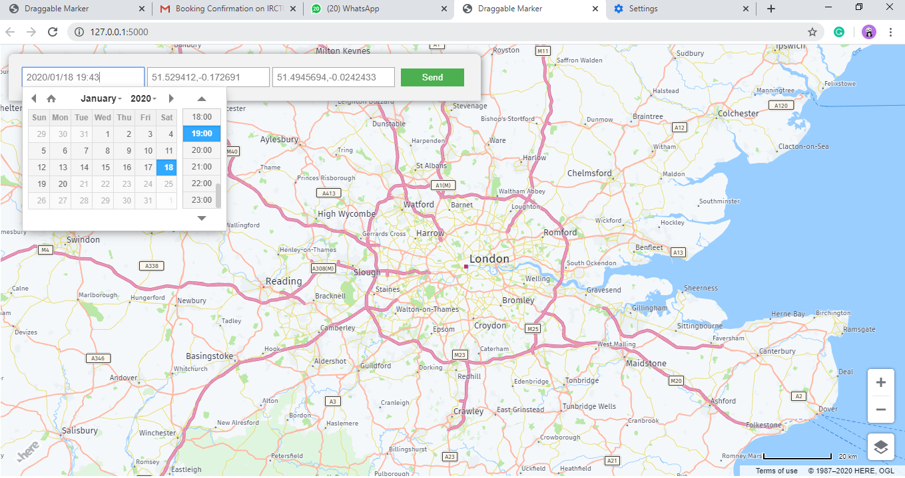
Depolyment with flask : -

Slide 9

THANK YOU

